Slide 1


INTERNSHIP
MD. Raisul Islam Aupi
Registration No. - 201883005
Dept. of Software Engineering
IICT, SUST
AT

Slide 2






1
Team Assignment
Assigned to Klikit team.
Integrated Partners

Slide 3
2
Breaking down the Internship
Learning Period.
Live Project Involvement.

Slide 4
3
Learning Period
Learning the basics of Golang & adjusting.
Bi-weekly progress check.

Slide 5
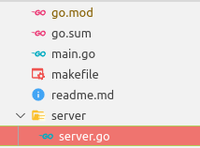
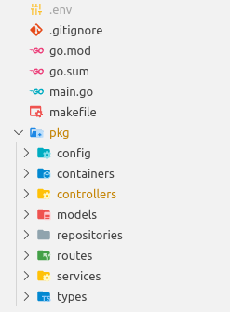
4
Learning Period
Creating a Web-Server.
Creating a Simple CRUD app using Go.

Slide 6
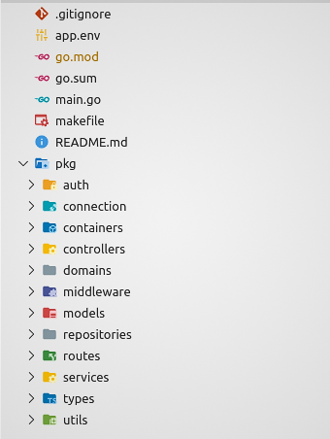

5
Learning Period
Learning ECHO framework.
Doing a more advanced project.

Slide 7
6
Live Project Involvement
Services directly worked on -
Menu Version 2
Menu Uploader
Gojek Integration (Klikjek)

Slide 8
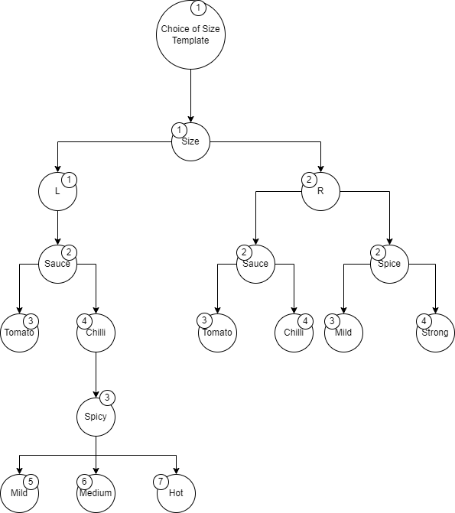
7
Live Project Involvement
Menu Version 2
Reduced database call to a constant for menu CRUD system, reducing scope of failure and optimized the process to linear time.
Implemented this optimization for publish feature.

Slide 9
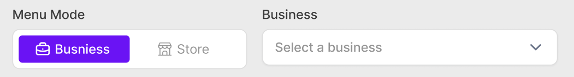
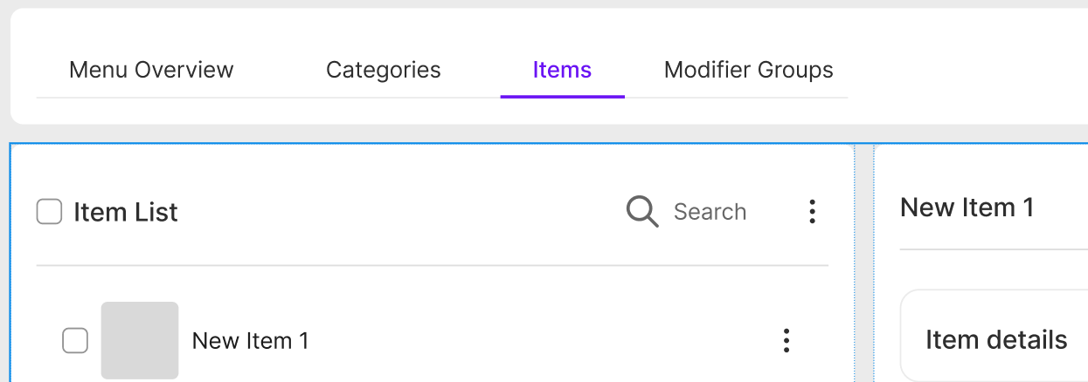
8
Live Project Involvement
Menu Version 2

Slide 10
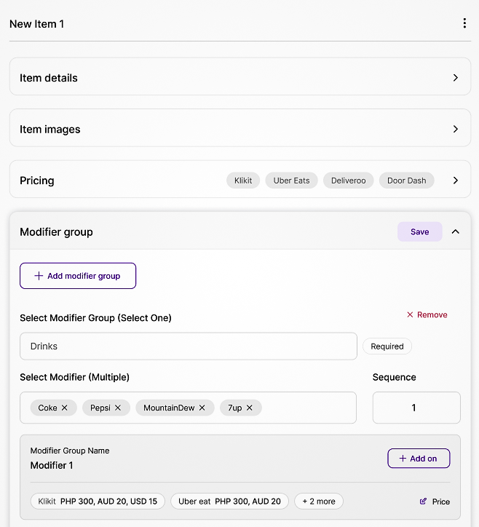
9
Live Project Involvement
Menu Version 2

Slide 11
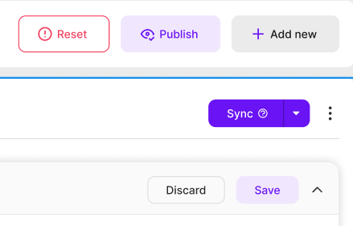
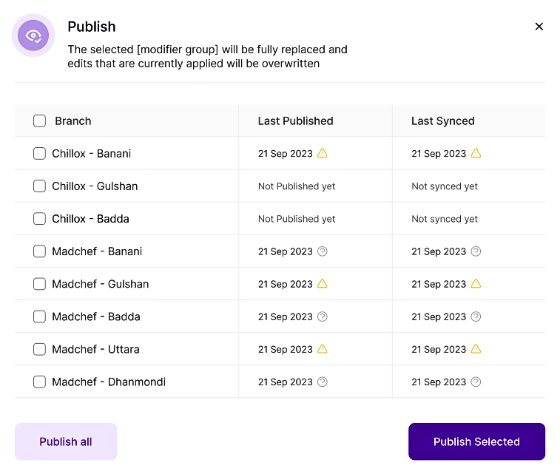
10
Live Project Involvement
Menu Version 2
Oversaw the implementation of two new features
Sync menu to store
Reset store menus

Slide 12
11
Live Project Involvement
Menu Version 2
Updated one existing feature
Publishing menu to stores.

Slide 13

12
Live Project Involvement
Menu Version 2
Introduced concurrency to all applicable APIs.
Took part in database design.

Slide 14
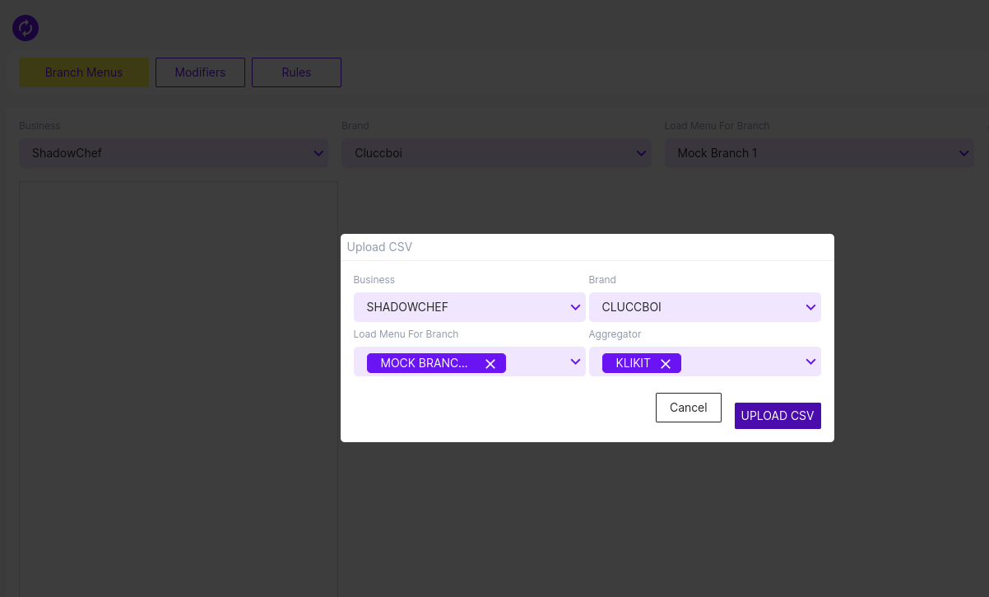
13
Live Project Involvement
Menu Uploader
Revised 80% of code of this service to integrate it with Menu service's version 2.

Slide 15
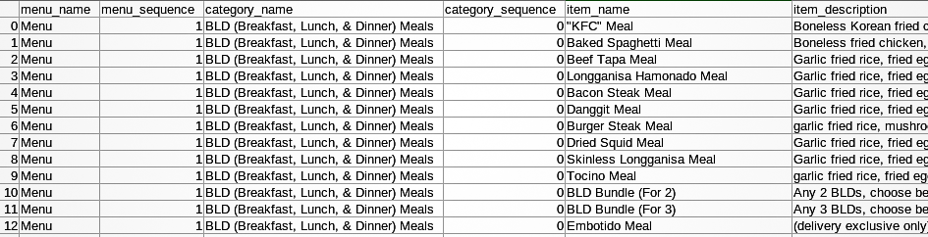
14
Live Project Involvement
Menu Uploader

Slide 16

15
Live Project Involvement
Klikjek
Got familiar with Gojek's food delivery platform Gofood.

Slide 17
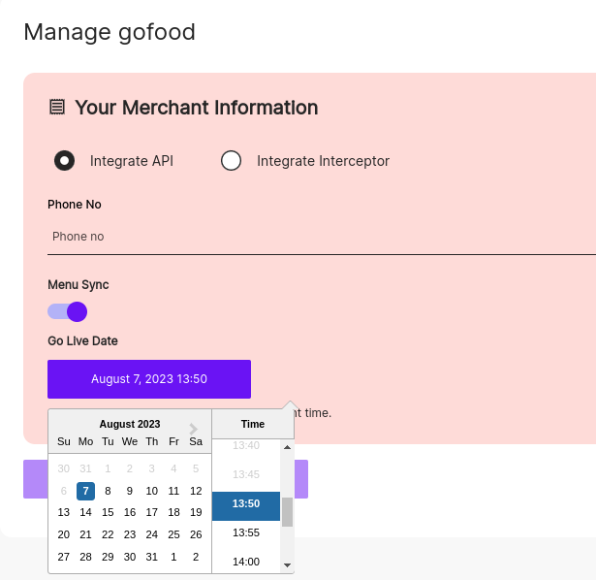
16
Live Project Involvement
Klikjek
Written the complete transform feature & identified dependencies for other changes.

Slide 18
THANK YOU
I am ready for your questions now.

